Slide 1


Drilling, Context and HOCs

Slide 2
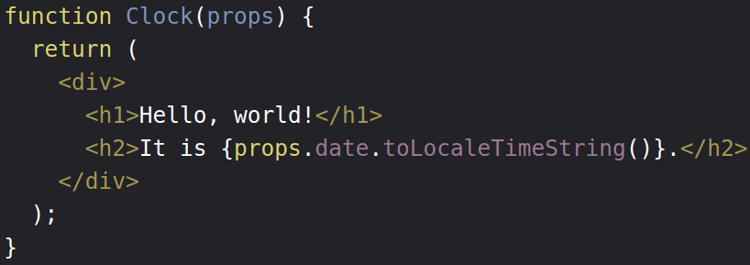
Function component

Slide 3
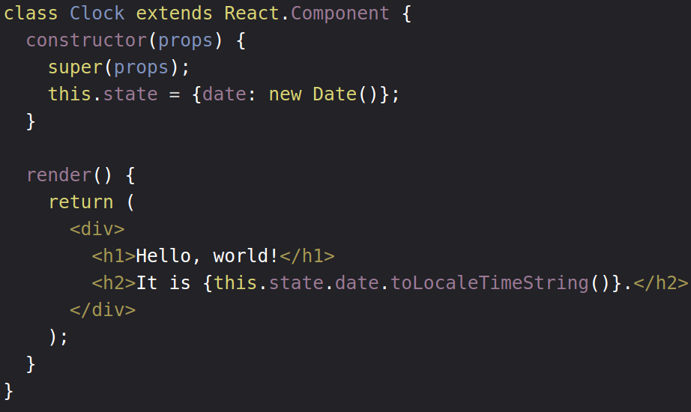
Class component

Slide 4
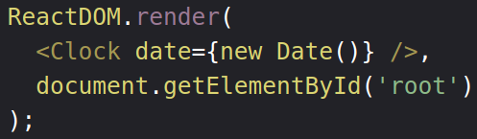
Props

Slide 5
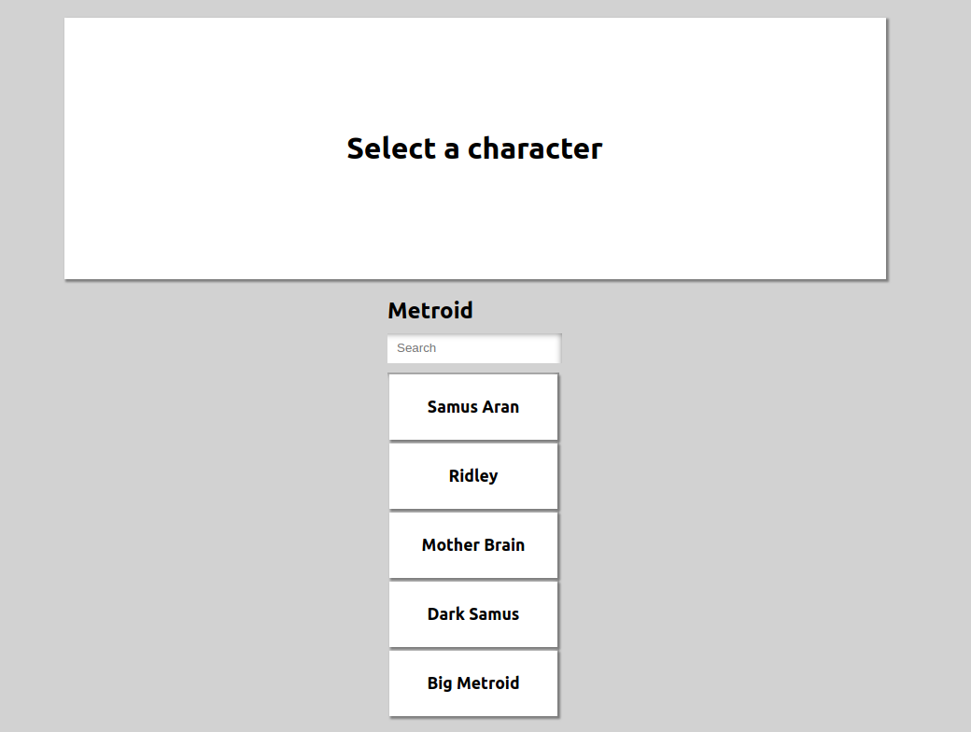
Our project

Slide 6
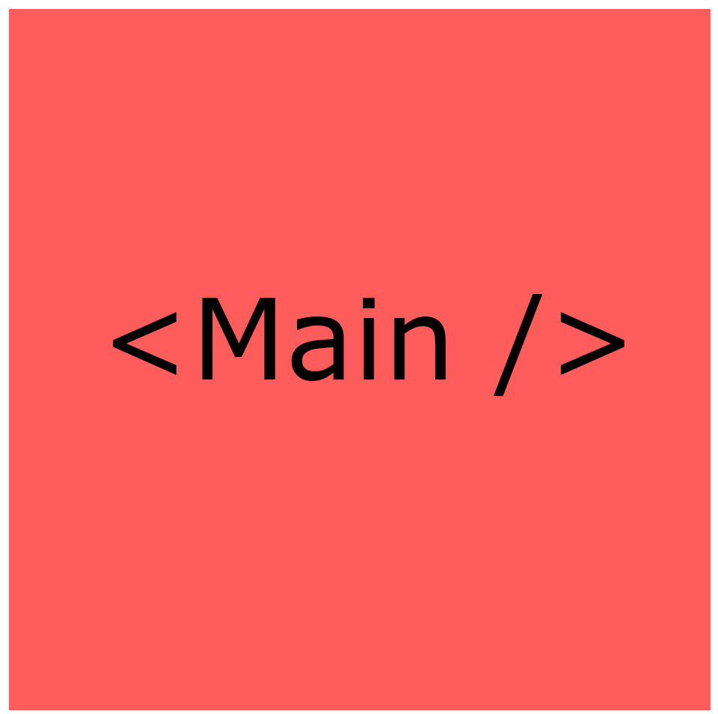

Slide 7
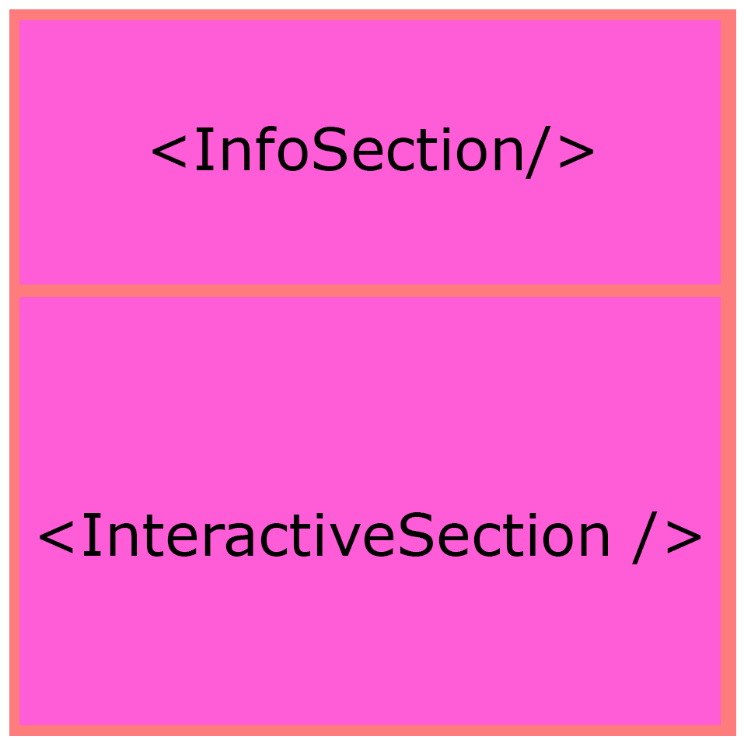

Slide 8
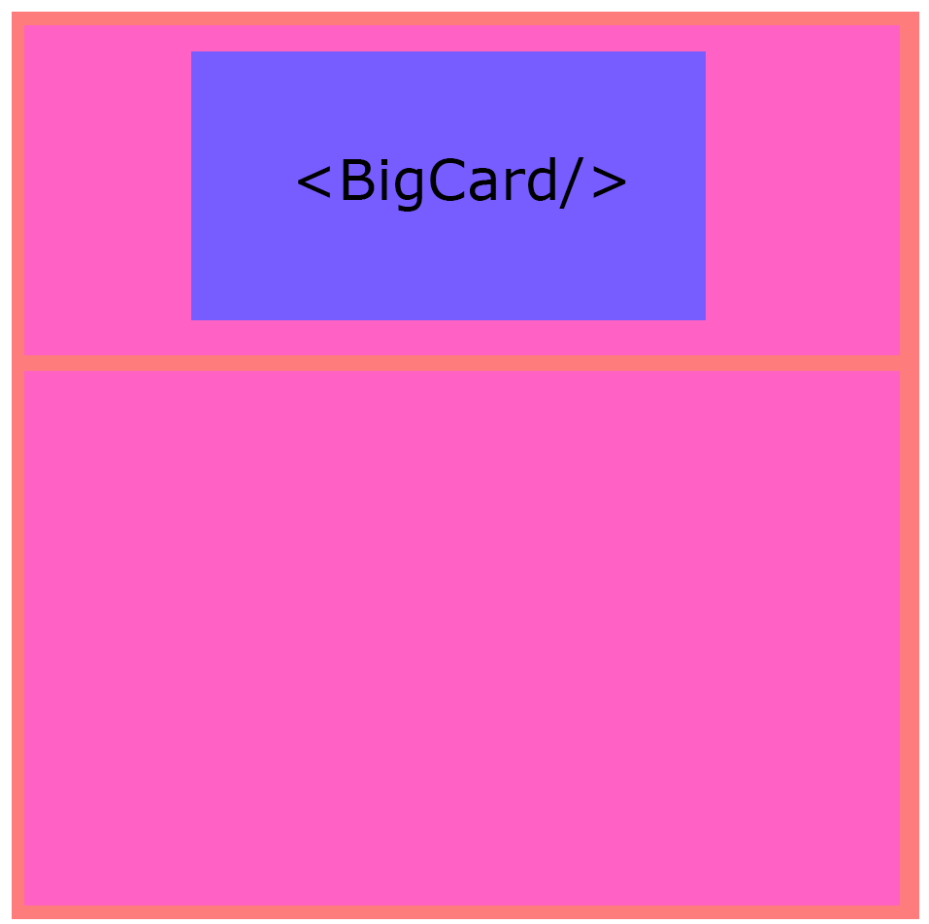

Slide 9
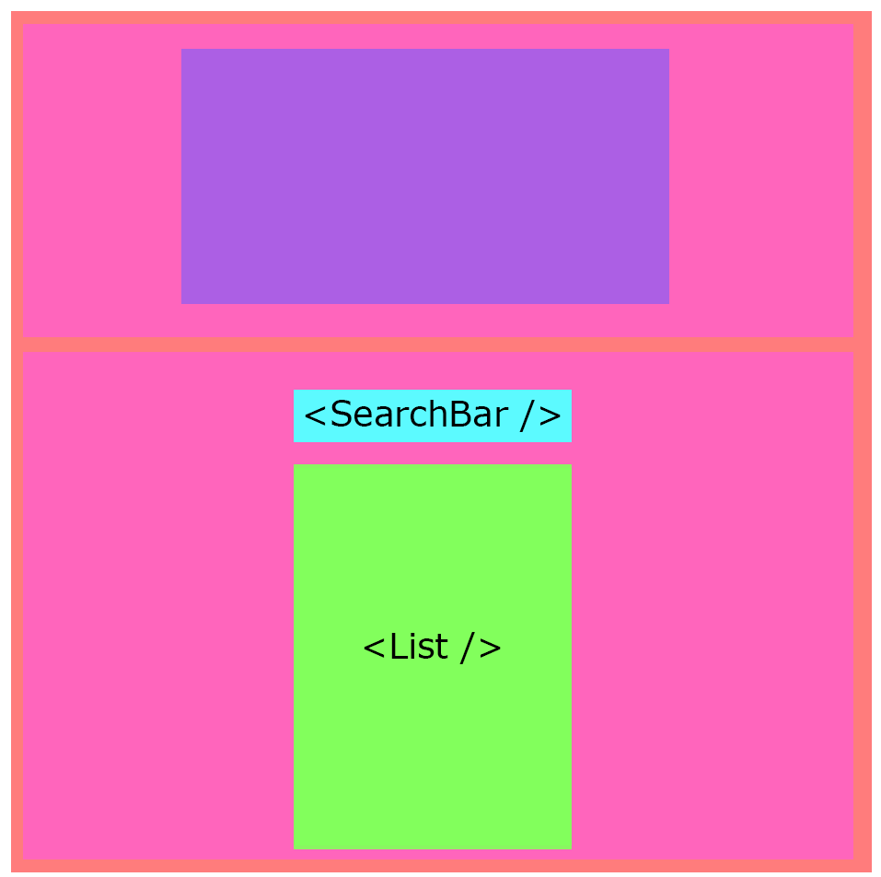

Slide 10
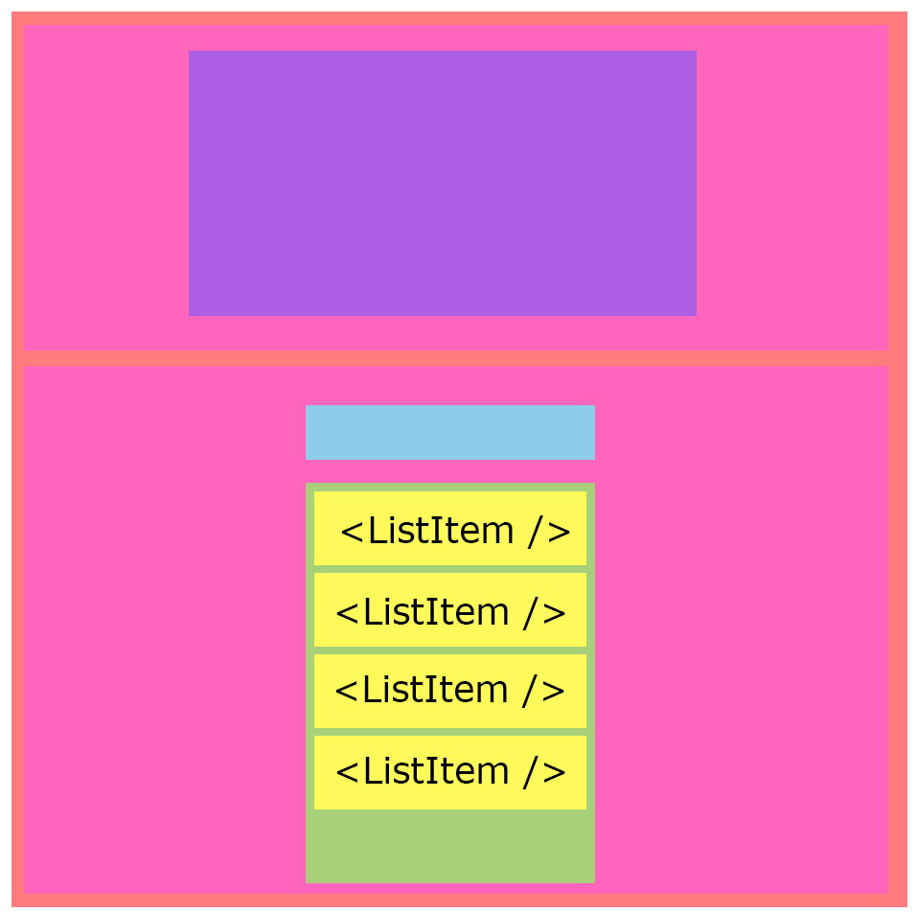

Slide 11
Drilling

Slide 12
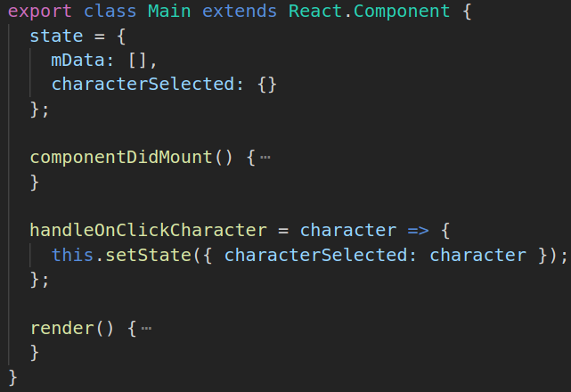

Slide 13
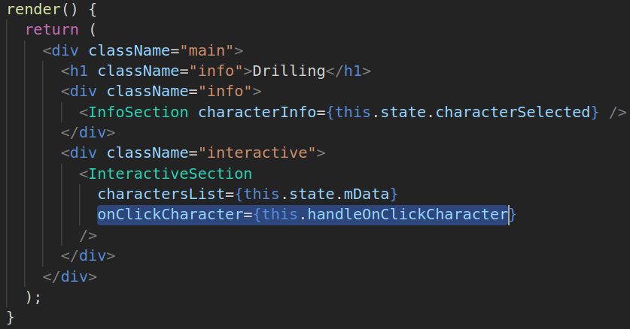

Slide 14
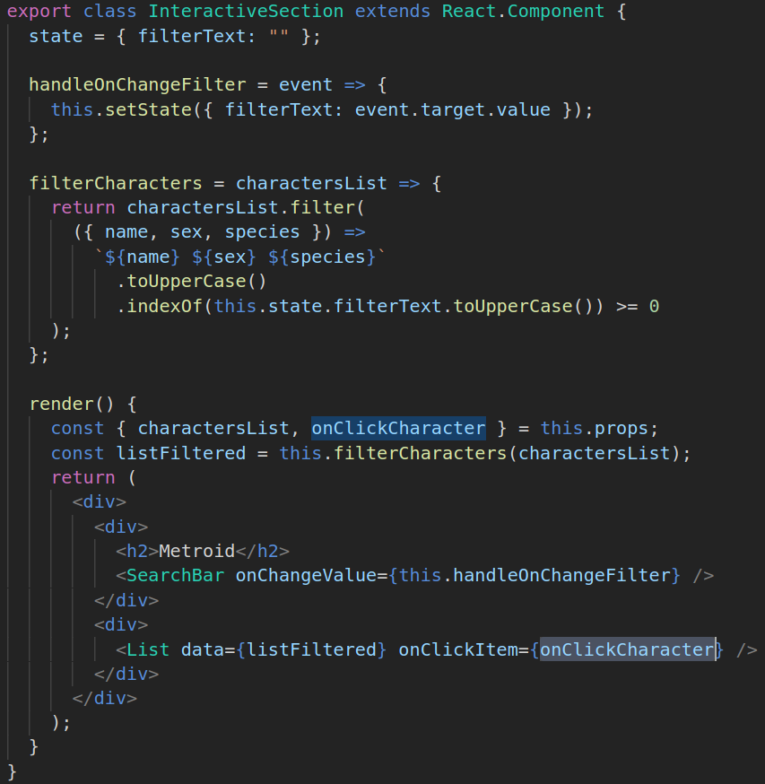

Slide 15
handleOnClickCharacter()
<Main />
<InteractiveSection onClickCharacter = { prop } />
<List onClickItem = { prop } />
<ListItem onClick = { prop } />

Slide 16
Context

Slide 17
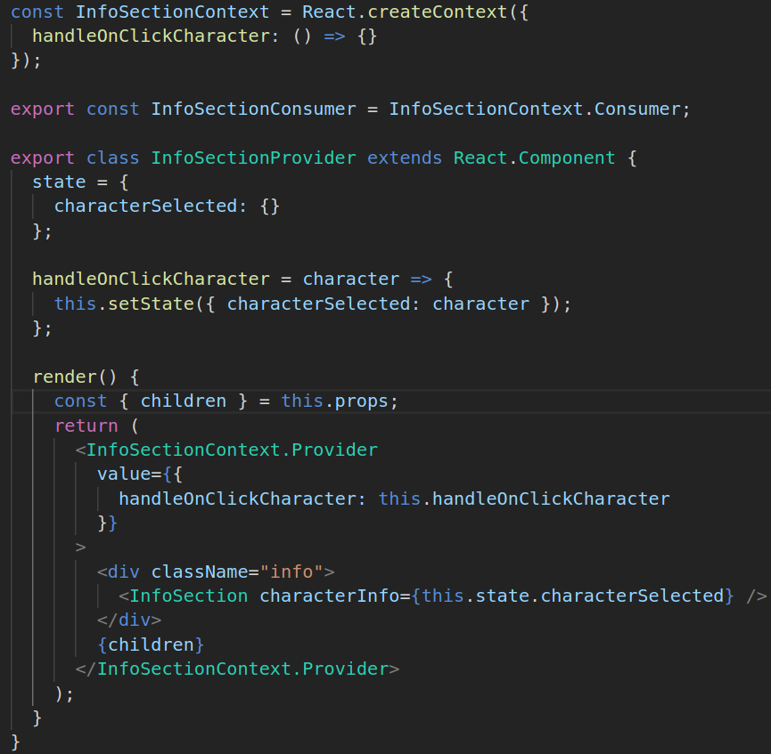

Slide 18
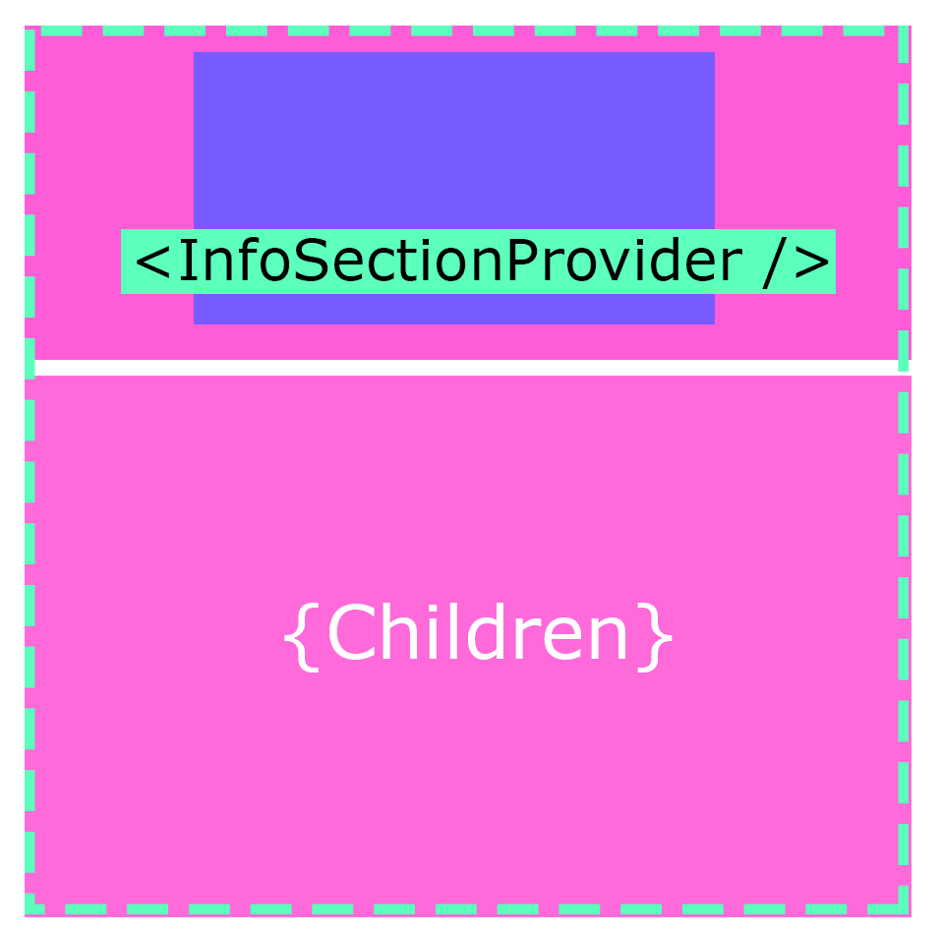

Slide 19
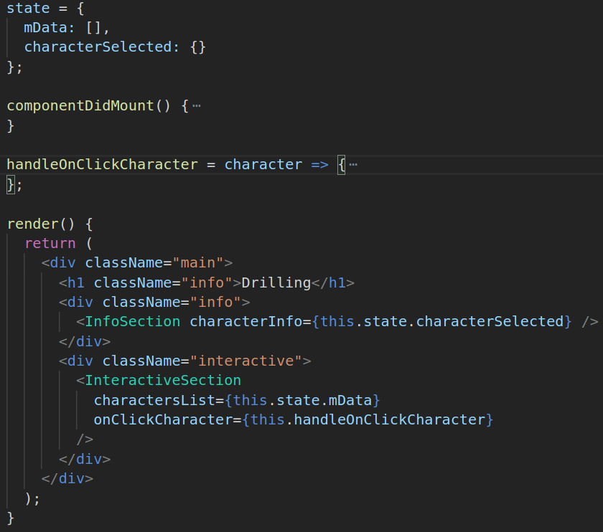
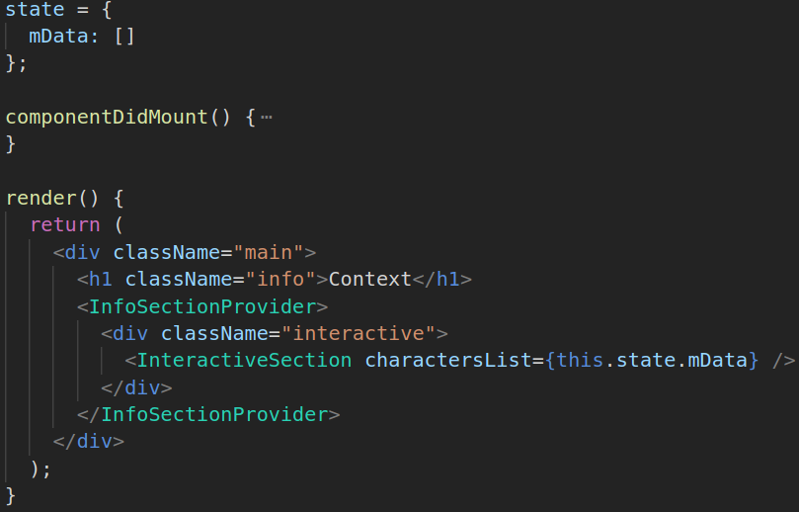
<Main />

Slide 20
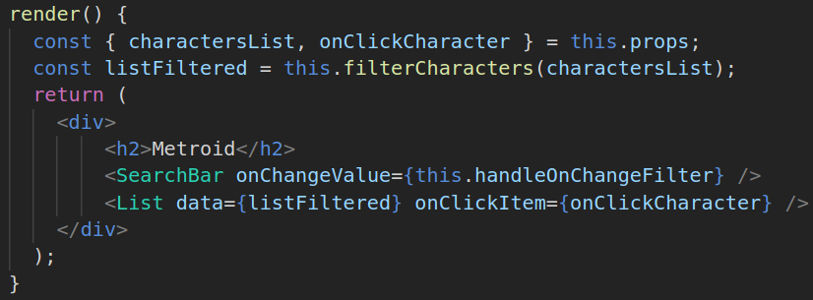
<InteractiveSection />

Slide 21
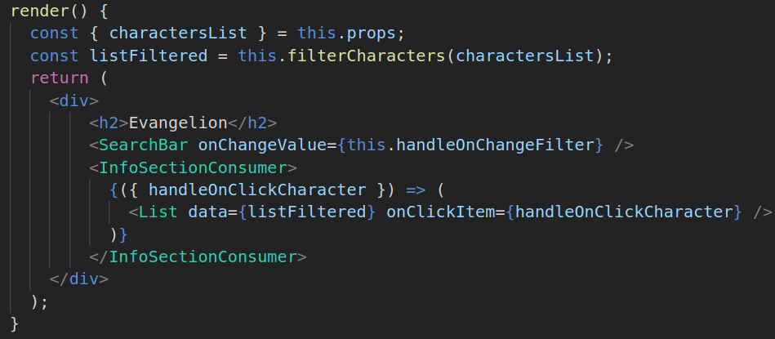
<InteractiveSection /> with consumer

Slide 22
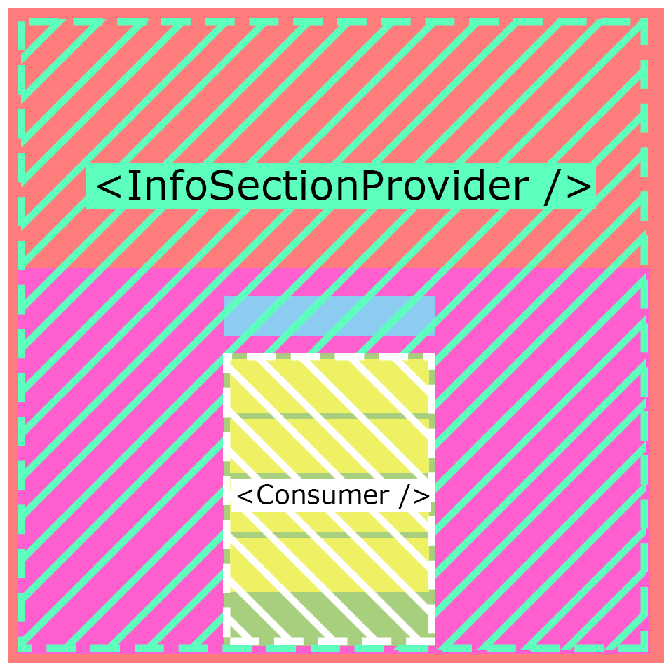

Slide 23
<Main />
handleOnClickCharacter()
<Provider />
<InteractiveSection onClickCharacter />
<Consumer />
<List onClickItem = { prop } />
<ListItem onClick = { prop } />

Slide 24
HOCs
High Order Components

Slide 25
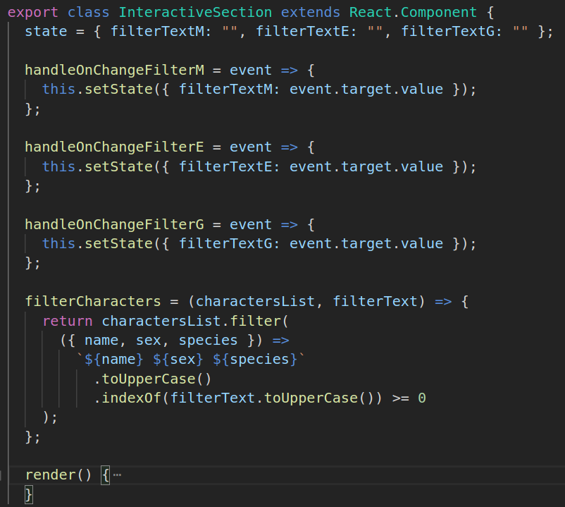

Slide 26
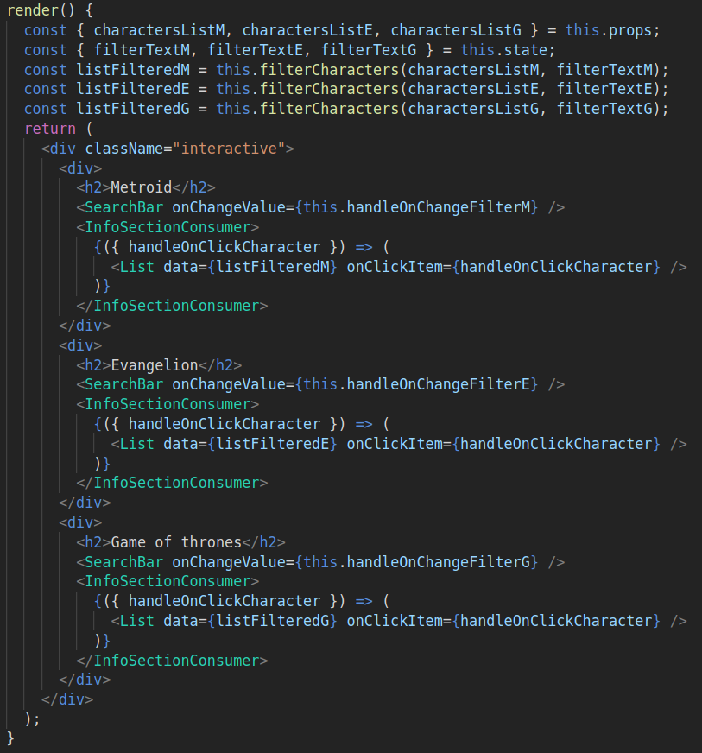

Slide 27
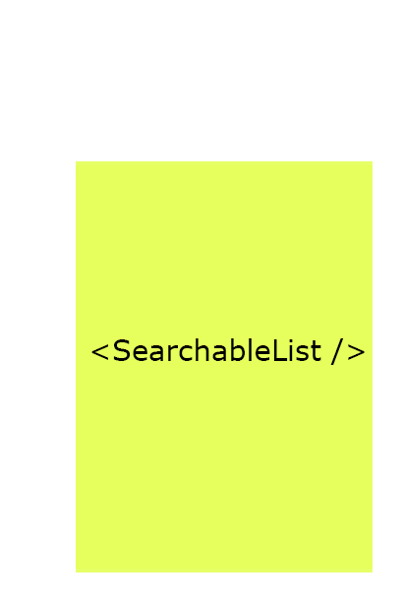

Slide 28
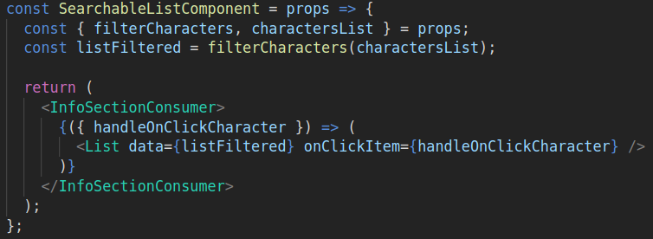

Slide 29


Slide 30

High Order Component

Slide 31
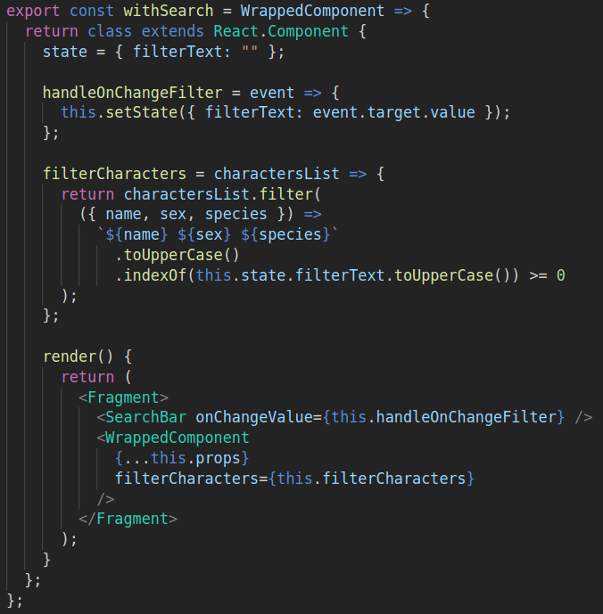

Slide 32
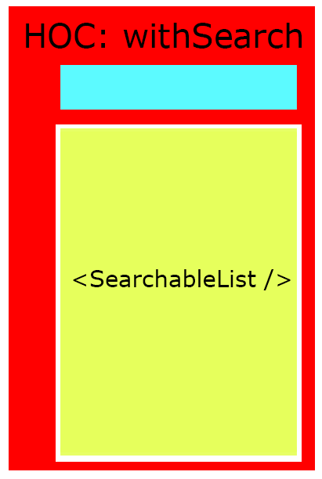

Slide 33
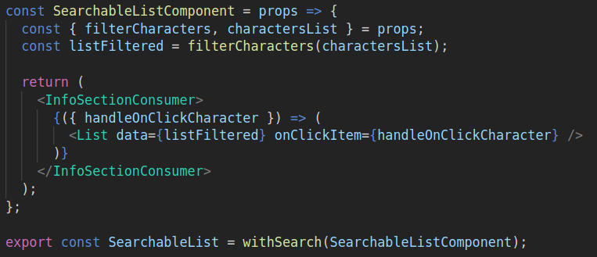

Slide 34
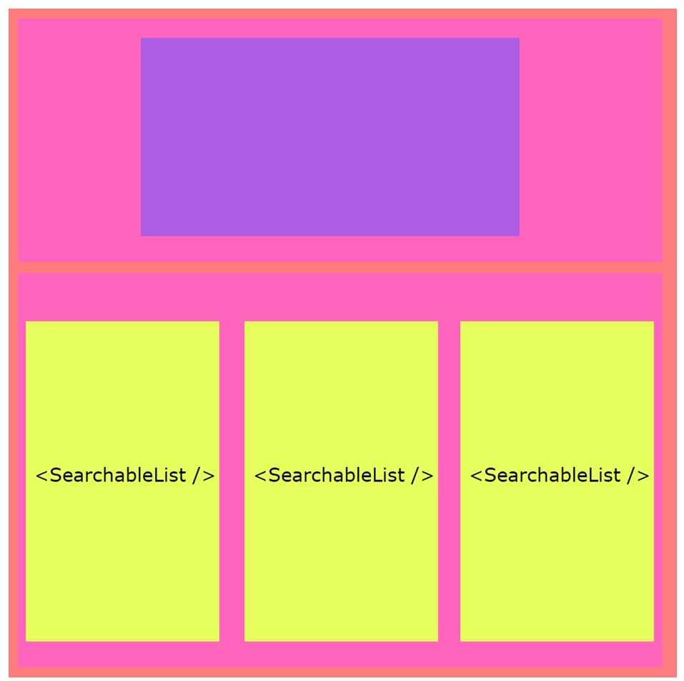

Slide 35
